Slide 1

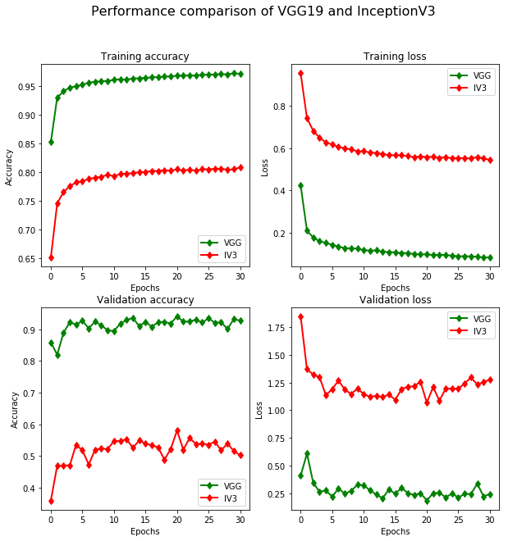
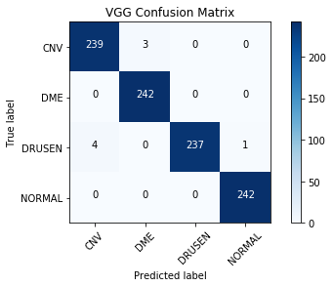
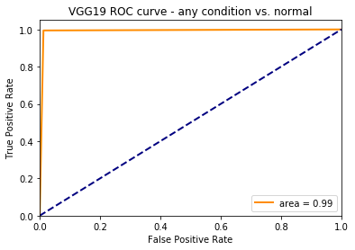
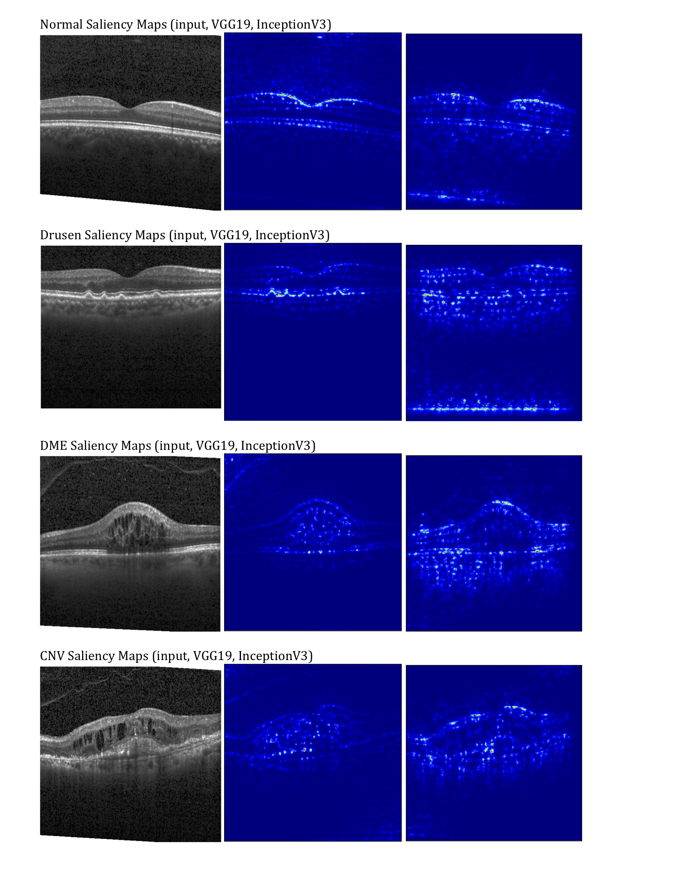
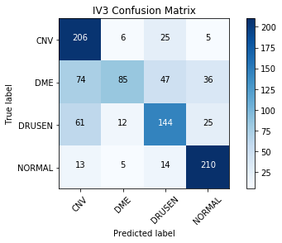
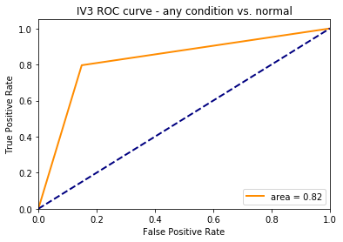
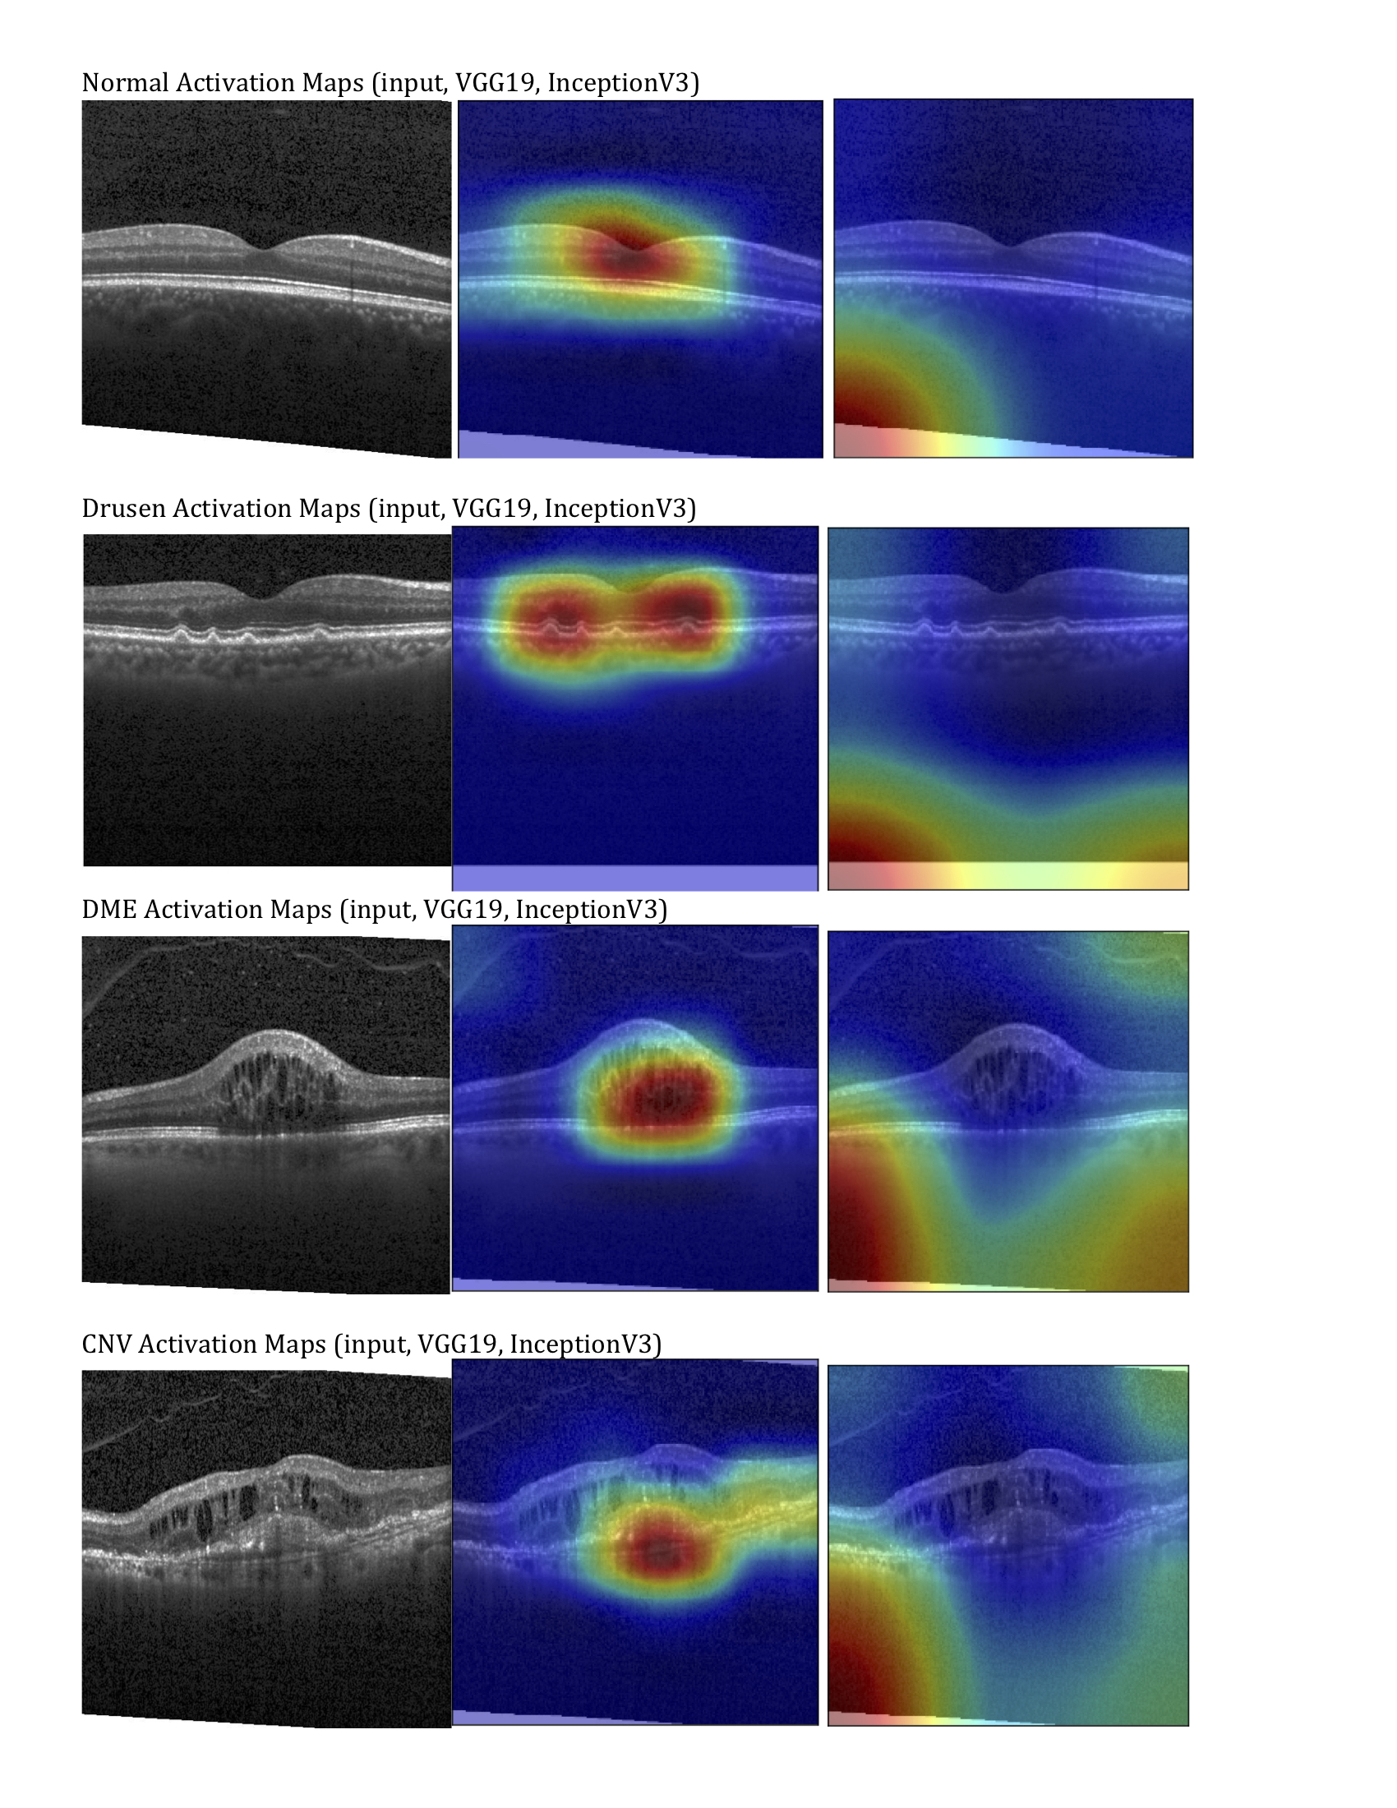
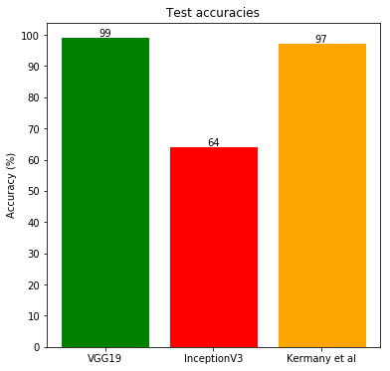
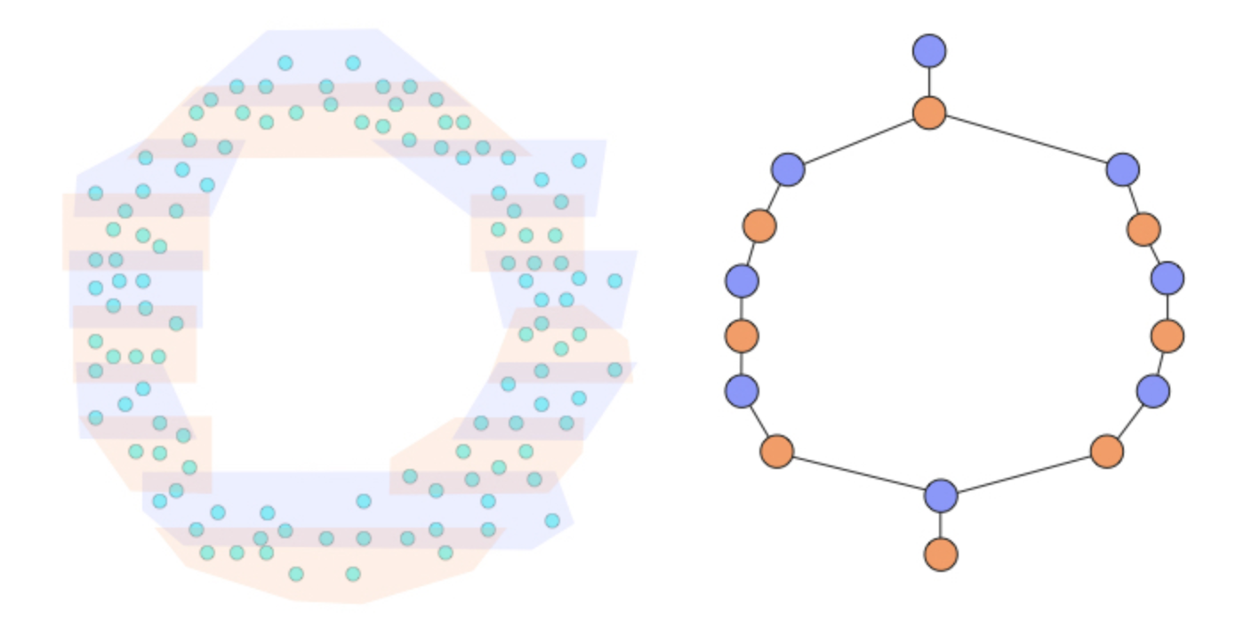
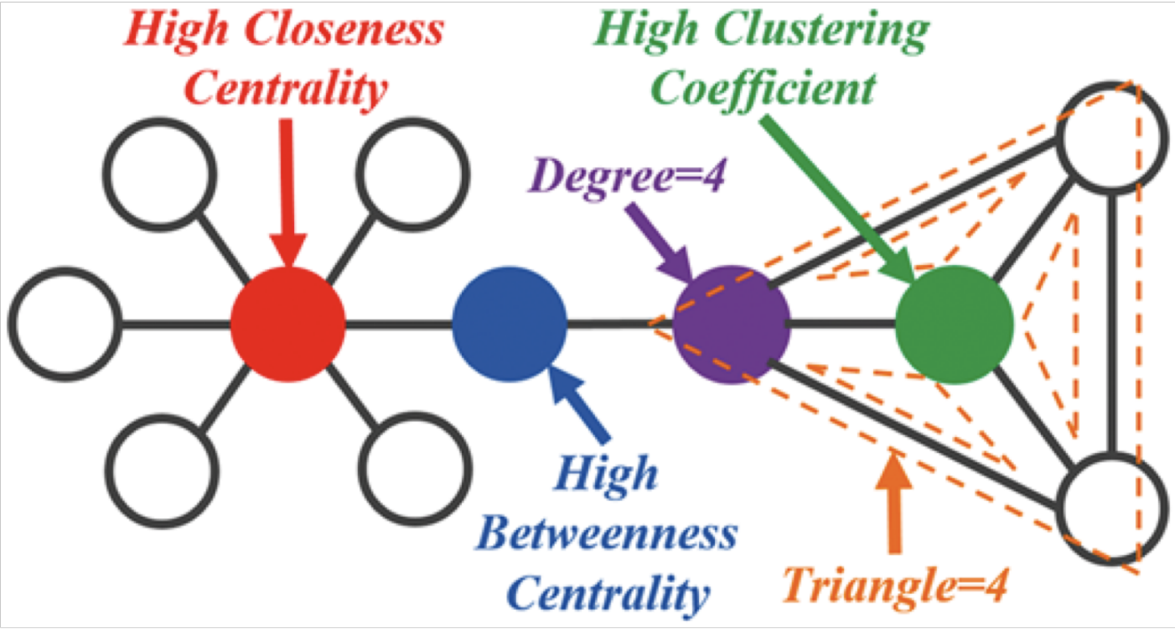
Exploring the functional networks of the resting brain with topological data analysis
Rafi Ayub^{1,2}
¹Department of Bioengineering
²Department of Psychiatry and Behavioral Sciences
Introduction
Results and Discussion
Background
The brain exhibits intrinsic activity with nuanced structure and rich dynamics even at rest when it is performing no explicit task [1]
Consistent patterns of correlations between regions, known as resting state networks (RSNs) show diverse interactions at rest
Psychiatric disorders have been linked to the dysregulation of these networks; changes in mood or arousal can also affect network dynamics [2][3]
Problem
Current methods of characterizing resting state functional connectivity are linear and may fail to reveal important non-linear structure and relationships between brain regions and networks
How does physiological state, such as fasting, change brain dynamics?
Solution
Non-linear methods from topological data analysis (TDA) may provide unique insight into the brain’s functional architecture
Figure 4: Saliency maps of both models indicating which pixels in each sample image contribute most to class score.
Methods
Figure 1: Comparison of the VGG19 and InceptionV3 training and validation accuracies and losses.
Figure 2: Confusion matrices and ROC curves for both models. Precision and recall for VGG was 100% and 99.8%, respectively. Precision and recall for IV3 was 95.4% and 90.9%, respectively.
Dataset
MyConnectome: complete metabolic profile + 84 fMRI scans of a single subject over a year – 31 in fed state, 40 in fasted state
Mapper
Tool from TDA/manifold learning that can capture the structure of the data
Project data into lower-dimensional embedding using tSNE
Bin points according to resolution parameter
Bins on lower-dim points guide partial clustering on original high-dim points – we use hierarchical clustering, HBDSCAN
Result is a graph that represents the “shape” of original data
Network analysis
Betweenness centrality
Within-module degree
Participation coefficient
Modularity/community structure
Stochastic Block Model
InceptionV3 consistently performed worse than VGG by 20% in training accuracy, 40% in validation accuracy, despite its touted ability to capture finer features within the images
IV3 model misclassifications and class activation maps indicate that the model is not picking up important features in the images and could have been trained incorrectly
VGG19 performed better than previous study [4] and IV3 on test dataset, and can identify pathophysiologically relevant features
Figure 3: Comparison of performances of each model on the test dataset, rounded to the nearest percent.
Figure 5: Class activation maps of both models indicating image regions CNN classifiers utilized to determine category.
Stochastic block model. Adapted from [4]
Conclusions
References
Illustration of the Mapper algorithm,. Adapted from [6].
Transfer learning can be effectively applied to train deep learning classifiers on medical images
VGG model can successfully determine OCT images containing pathological features
VGG model can be used to highlight physiologically relevant regions of interest to assist practitioner
Deco, G., Jirsa, V. K., & McIntosh, A. R. (2013). Resting brains never rest: Computational insights into potential cognitive architectures. Trends in Neurosciences, 36(5), 268–274. https://doi.org/10.1016/j.tins.2013.03.001
Xu, T., Cullen, K. R., Mueller, B., Schreiner, M. W., Lim, K. O., Schulz, S. C., & Parhi, K. K. (2016). Network analysis of functional brain connectivity in borderline personality disorder using resting-state fMRI. NeuroImage: Clinical, 11, 302–315. https://doi.org/10.1016/j.nicl.2016.02.006
Poldrack, R. A., Laumann, T. O., Koyejo, O., Gregory, B., Hover, A., Chen, M. Y., … Mumford, J. A. (2015). Long-term neural and physiological phenotyping of a single human. Nature Communications, 6. https://doi.org/10.1038/ncomms9885
Abbe, E., Bandeira, A.S., & Hall, G. (2016). Exact Recovery in the Stochastic Block Model. IEEE Transactions on Information Theory, 62, 471-487.
Jure Leskovec, Stanford CS224W: Social and Information Network Analysis, http://cs224w.stanford.edu
Saul, Nathaniel. What is Mapper? https://sauln.github.io/blog/mapper-intro/
Depiction of betweenness centrality. Adapted from [5]

